Slide 1
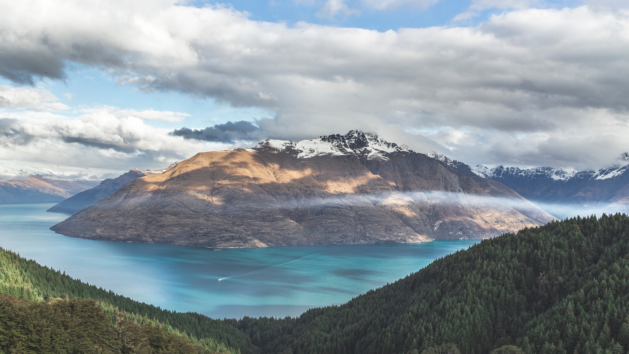

LASSARNACH
A CONCEPT OF A GREAT KINGDOM

Slide 2
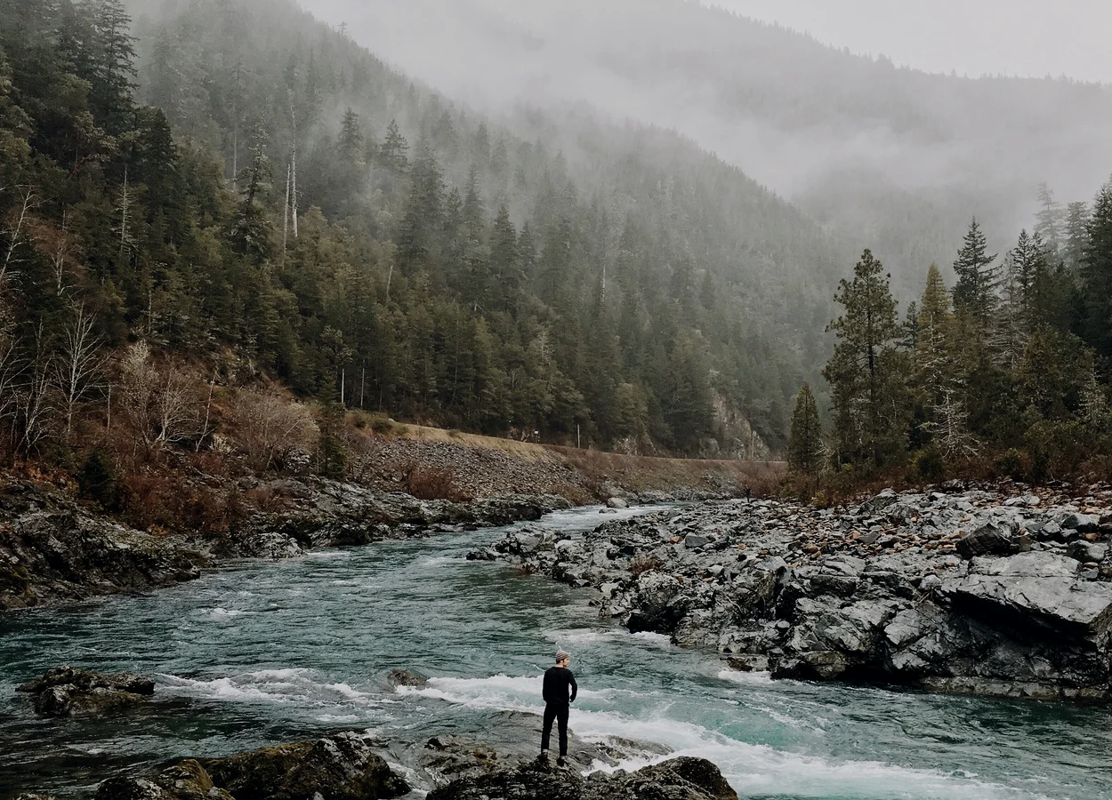
Greetings,
MY NAME IS JONNALAGADDA RATHNA KAMAL; AN ASPIRING STORY WRITER AND HAVE A KEEN EYE FOR CREATIVE REGARDING QUEST DEVELOPMENT AND DESIGNING IT. THIS MY STORY APPLICATION REGARDING TO JOIN YOUR COMPANy AS AN ‘INTERN’ IN GAME PLANNER FOR QUEST DESIGNING AND DEVELOPMENT.
IF YOU LIKE MY STORY OR MY APPLICATION WE CAN TALK IT OVER AND CAN MOVE FORWARD WITH NEXT STEP, THANK YOU.
THE STORY PRESENTED IS MADE OF FICTION.IF THERE ARE ANY KIND OF RESEMBLANCES TO THE REAL WORLD IN THE FORM OF NAMES , PLACES, THINGS; THOSE ARE PURELY COINCIDENTAL AND NOT BY MEANS REFERRING TO ANY REAL LIFE CHARACTERS; THANK YOU.

Slide 3
The Given PPT will be a read-only File. The slide show will be in it’s best format form so that you the “Reader” can enjoy.
Thank you.
-Rathna Kamal.

Slide 4
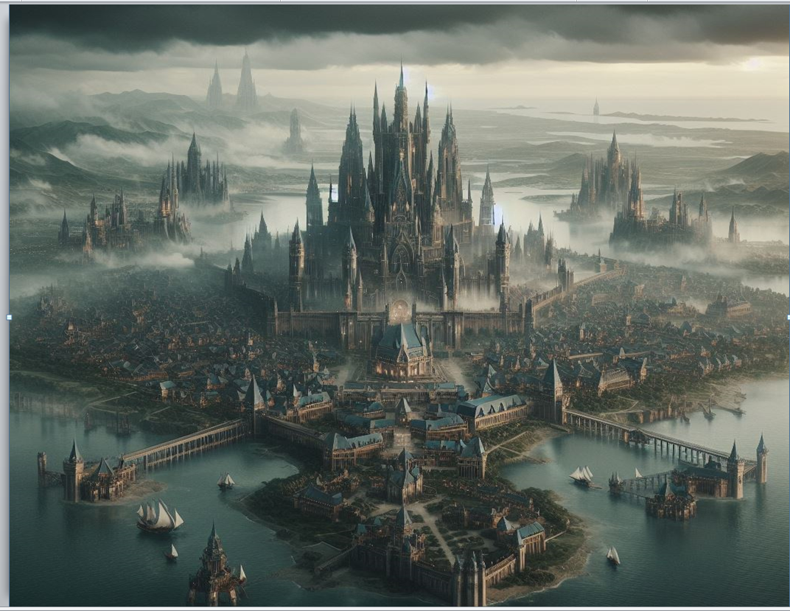
Introduction
THE LASSARNACH,
A KINGDOM BEYOND IT’S TIME,
RULED BY SEVERAL KINGS,
DEFIED MORTAL IMAGINATION,
AS IF THE PAST AND THE FUTURE CONVERGE,
IN THIS TIMELESS TAPESTRY,
IT FLOURISHES BEYOND THE SKIES AND BEYOND THE VAST SEAS…

Slide 5
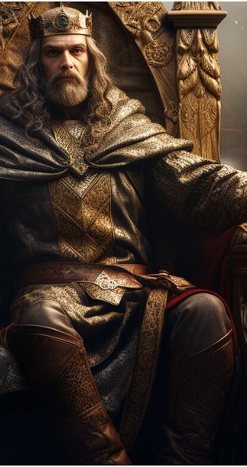

IT said that the Kings who Ruled over Lassarnach Said to be the Strongest, The Wisest and the Greatest of them all as whoever rules the kingdom of lassarnach is said to have gained immense power rival to that of gods even.
The rumor turned into a Story and the Story into a Myth and that Myth Turned into a Legend.
People and the kings all over the world came to lassarnach in the hopes of conquering it and gaining the powers for themselves, In the end the lassarnach came under the rule of the ‘Erik’ the ruler of the ‘Vikings’.
The vikings ruled over the lassarnach with an Ironfist over the people and gained their bearing fruits just for them. the main city was named ‘Dragonaut’ where the king and his most trusted officials live.

Slide 6
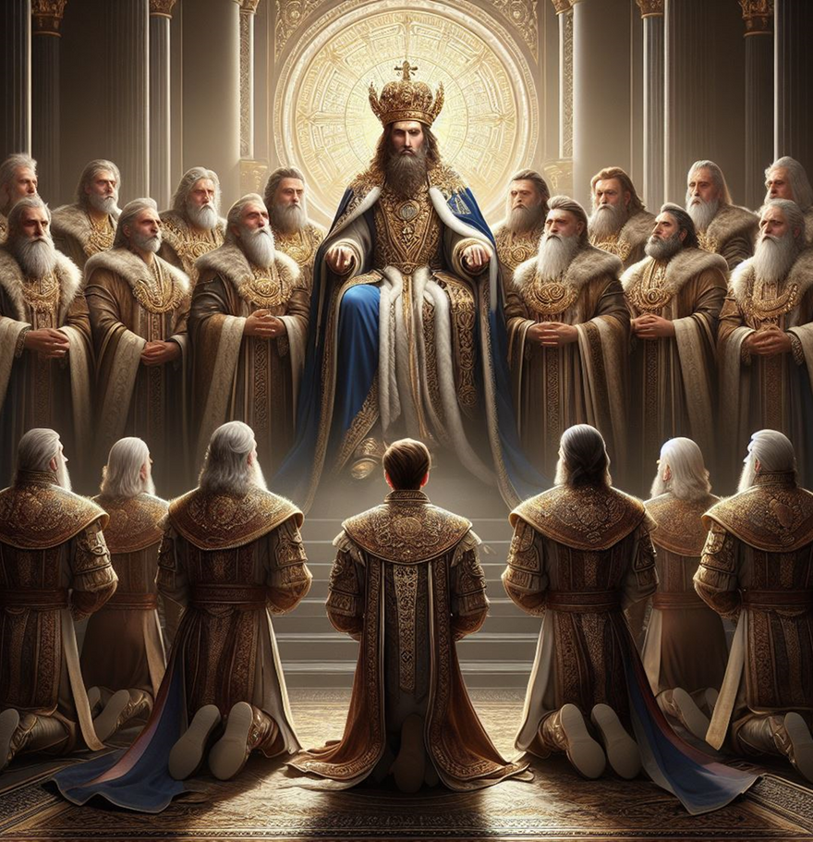
‘Strasgaard’ was the sixth Ruler of under the viking Regime.
Unlike his former kings; Strasgaard was different; He took care of his people. He was wise beyond his years and took steps that would benefit his people and his country very well.
He appointed seven warrior ministers under him That protect the vast kingdom that his forefathers made; through their skills, wit and determination in a war.
Even though every thing was going well for the king he had one issue lingering in his mind;
The quest for gaining knowledge in the entire world.

Slide 7
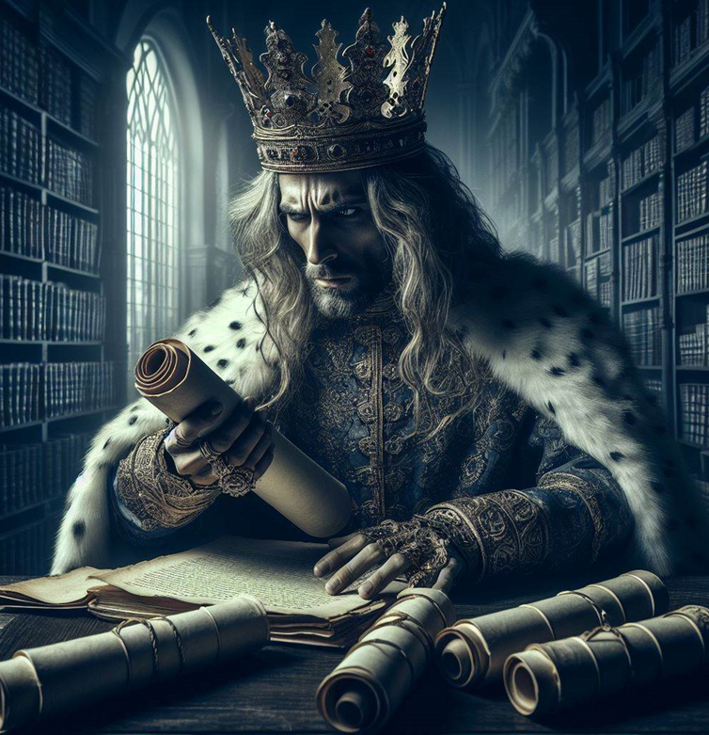
His thirst for knowledge and power led him to the ancient scrolls of the “divine energy” . the scrolls themselves were not the answer but it has given a secret path that only ‘the Chosen one’ would part take to achieve the divine knowledge given to him.
The king took the path given in the scrolls and gave the kingdom to his wife and his trusted minister ‘Leonard’ until he comes back.
The king travelled all around following the path given to him, even though it is treacherous and many times he was faced by the blades of death, but; he continued with will and determination in his heart and to fulfill his ‘destiny’.

Slide 8
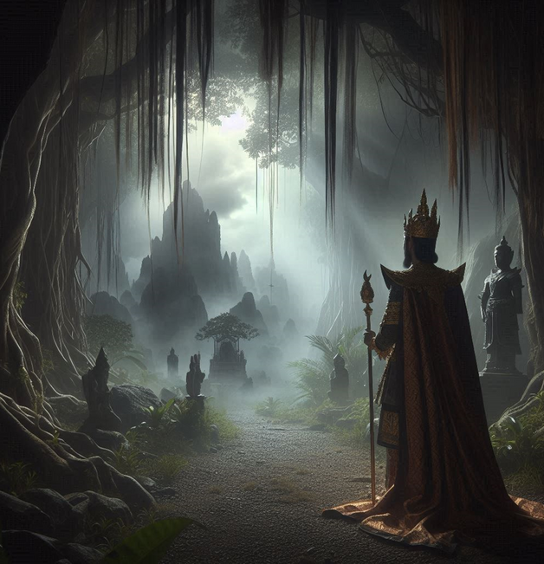
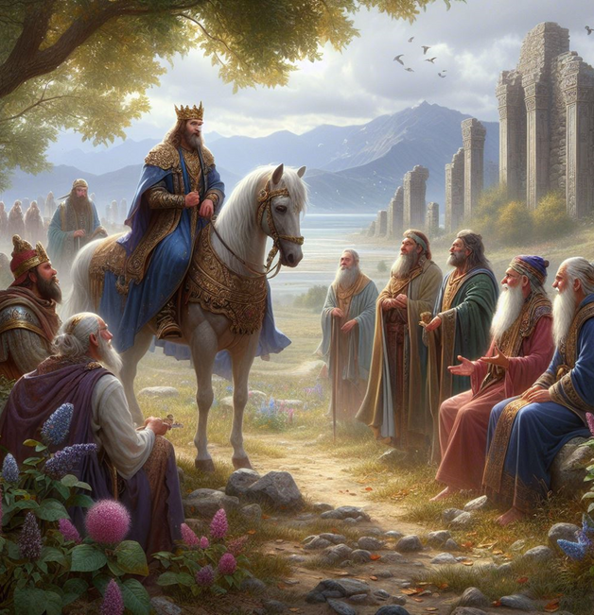
In the end the king found a cave and through the usage of the scroll he went through it and found the place where the ‘sages’ were waiting for him.
The sages took care of the king and the king offered them to come to his kingdom and bless his people as they did to him. The sages seeing his good heart sent ten of them with him as the king wished.
The ‘sages’ were impressed by the hospitality given to them and the people of the kingdom being happy and loving their king. The ‘sages’ blessed strasgaard with ‘Immortality’ through their divine energy and the land of lassarnach itself.
The Immortality in the sense the king will live as long as the people of lassarnach believe in him.

Slide 9
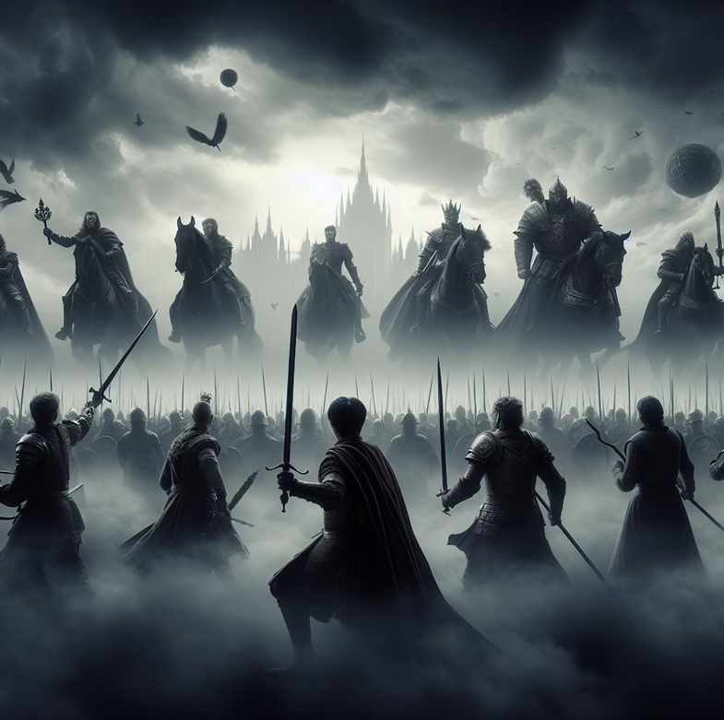
The ministers saw this wanted to gain the blessings of the divine sages from them as their king had.
To gain their attention each minister did something in the greatness of their king and brought gifts and lands to the sages to gain their hospitality.
The sages impressed by the ministers dedication granted them great skills they have that could use to topple a kingdom within a day itself.
With their new granted powers the warrior ministers started to wage wars against other kingdoms at a time and won against everyone.

Slide 10
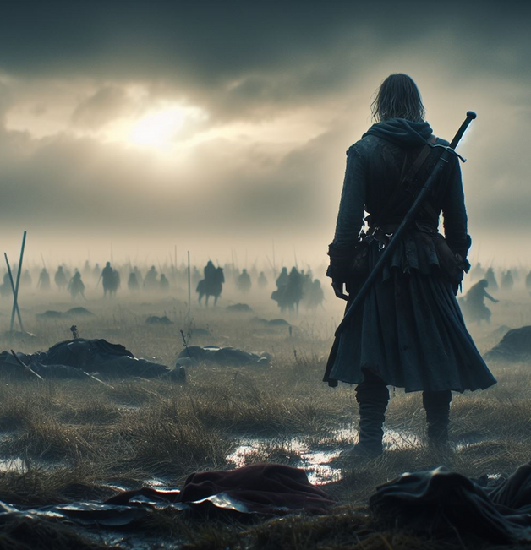
During this time ‘Leonard‘ became king’s army general and the first Minister to the king, Due to his skills and strength in waging wars and winning them.
Leonard had a ‘son’ who was blessed by the divine energy presented, and Due to that the boy grow up to be the best fighter/warrior in the entire kingdom of lassarnach itself, carrying a single sword on his back he was never defeated in his entire life.
The king made the boy as a royal protector to his two sons until his death.

Slide 11
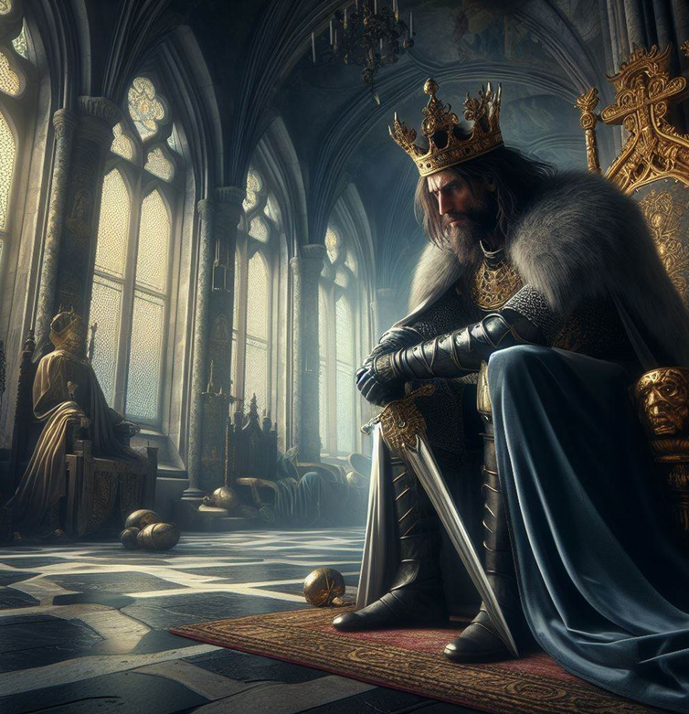
As the kingdom of lassarnach was getting bigger the king divided the entire kingdom into seven cities and made the seven ministers under him as the lords to their cities respectfully under one rule; “The king’s decree is and always will be the final verdict”.
The king and his family stayed in ‘Dragonaut’ and made the city as the capital to lassarnach with Leonard as it’s lord.
As the time passing by the king’s thirst for more knowledge beyond the sages grew more in him and slowly he was becoming doubtful and fearful against everyone.

Slide 12
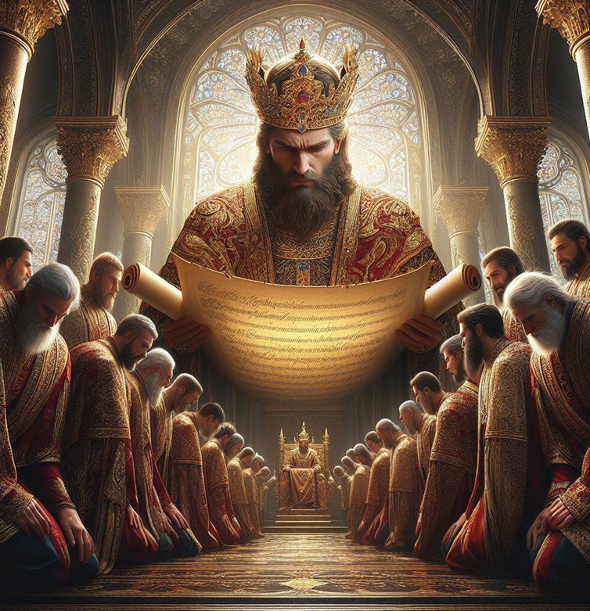
Due that; The king started to bring new rules stating that “only he the king should be praised and no one should ever cross his word if did they will be punished by exile or be killed”.
He increased the taxes paid by the people and kept an secret eye on the people using his spies, The lords even though did not liked the new rules of their king had no choice but to follow their king’s command.
The people who fought back against the king mostly were killed by the ruthless general Leonard and his son and the remaining were casted out of the kingdom as the stated them as the ‘Strayed ones’ people who lost the way and now will never have the chance to re-enter the kingdom again. If did they will be killed brutally.

Slide 13
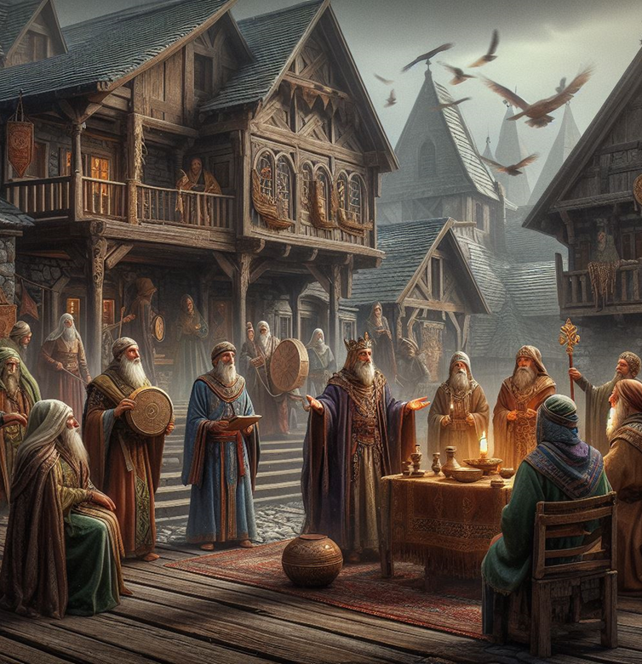
Starsgaard wanted more knowledge about the “Divine- energy”; he started to question the sages to know more about their origins and the energy itself.
The Sages tried to answer the questions but the king’s Un-quenched thirst made difficult for them to cope with the new ‘doubtful king’.
The king was afraid that the lords now having powers of the divine energy might start to a coupe against him, to gain more strength and immortality for his sons and himself; He corrupted some the sages to work for him using their knowledge and conducted a ritual to gain more power and knowledge.

Slide 14
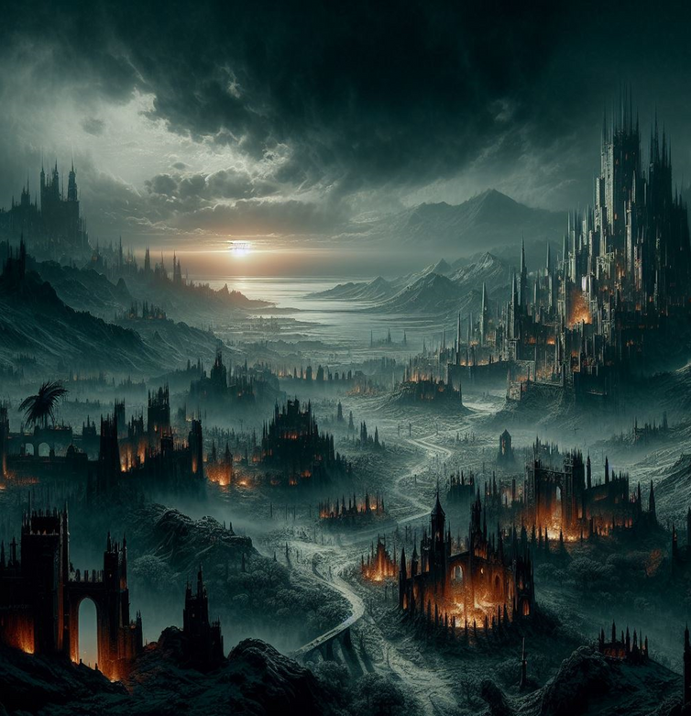
To complete the ritual the king with help of four sages, Leonard and his son committed crime so heinous that the ritual became a curse which in return cursed the entire kingdom
and it’s people to be “rotted for eternity”.
For more than centuries many warriors, mages, heroes, armies came to lassarnach to lift the curse as a new Myth formed
That;
“Who ever lifts the curse of lassarnach will be granted The Divine powers of the Gods themselves and will be a Immortal as along as Time exists”.

Slide 15
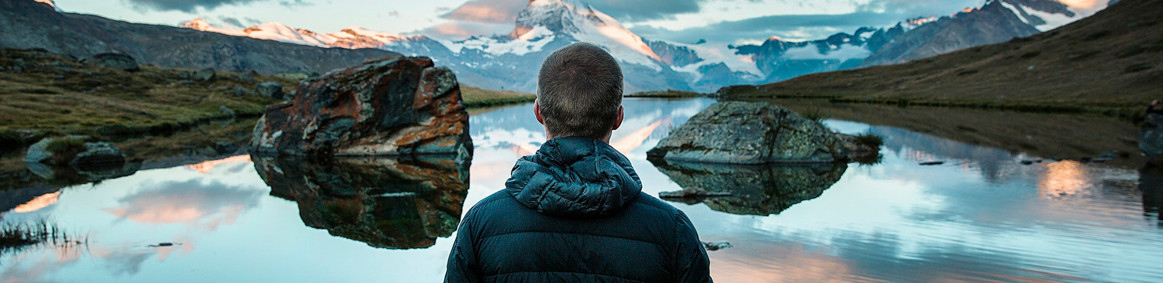
I hope the story meet your requirements, If or If not Thank you for taking time to read My short story; I have much more if you needed. Best Regards.
-RATHNA KAMAL
Contact:
Email:
Rathnakamaljonnalagadda2004@gmail.com

Slide 16

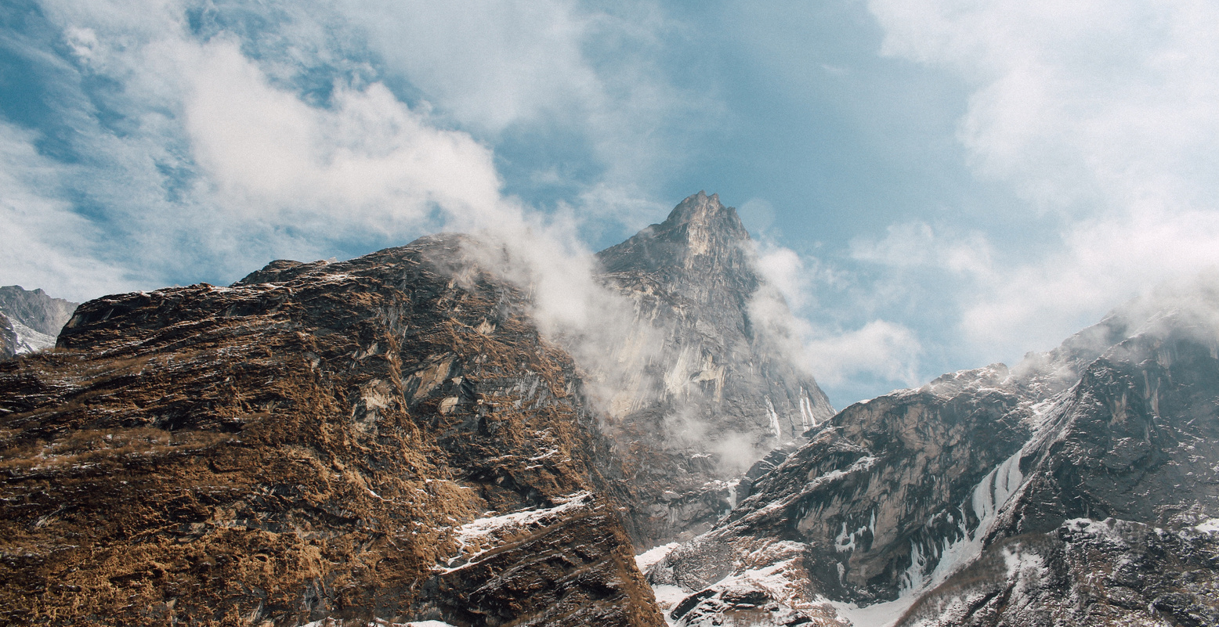
Thank You!
Life is either a
daring adventure or nothing at all.

